Slide 1
Latent Diffusion Models
Stable Diffusion
By Jakub Dylag

Slide 2
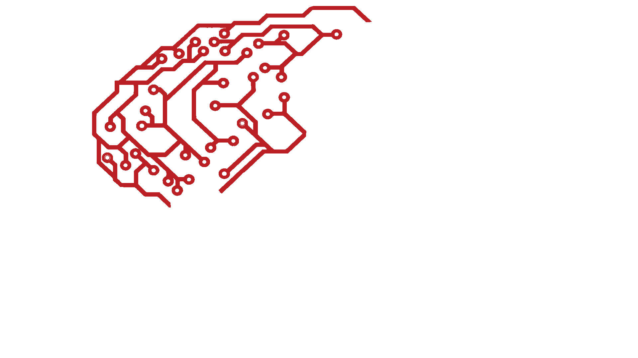
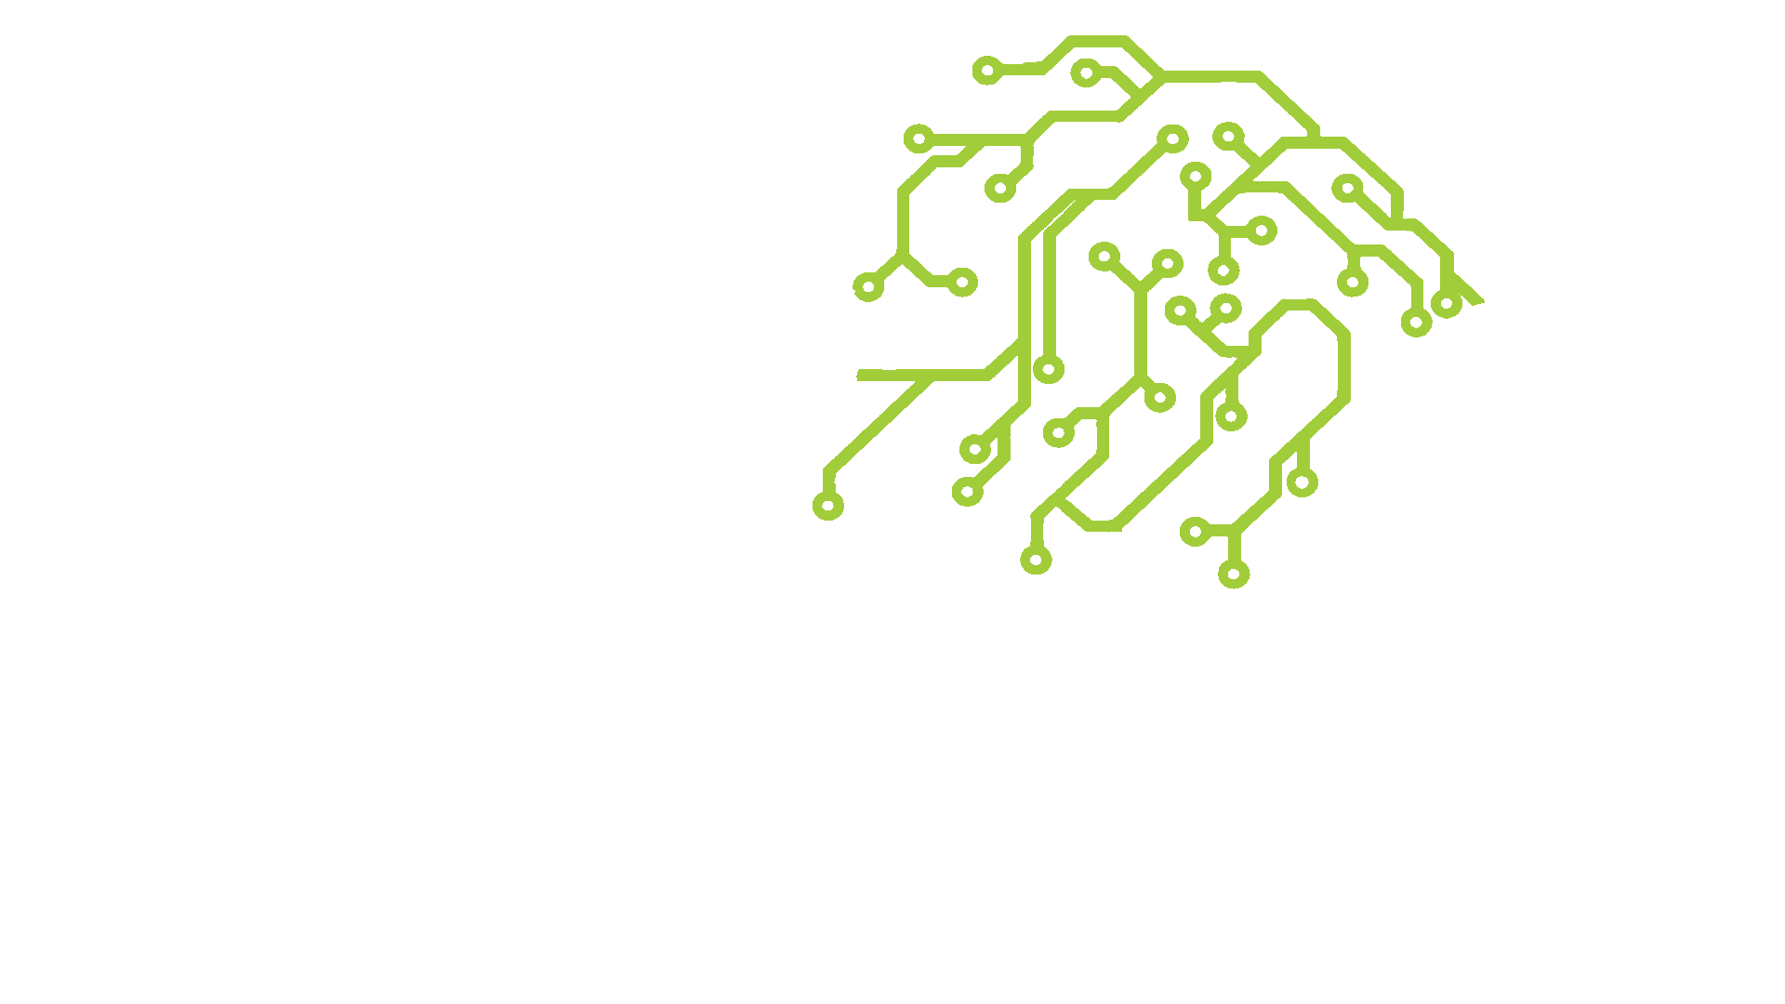
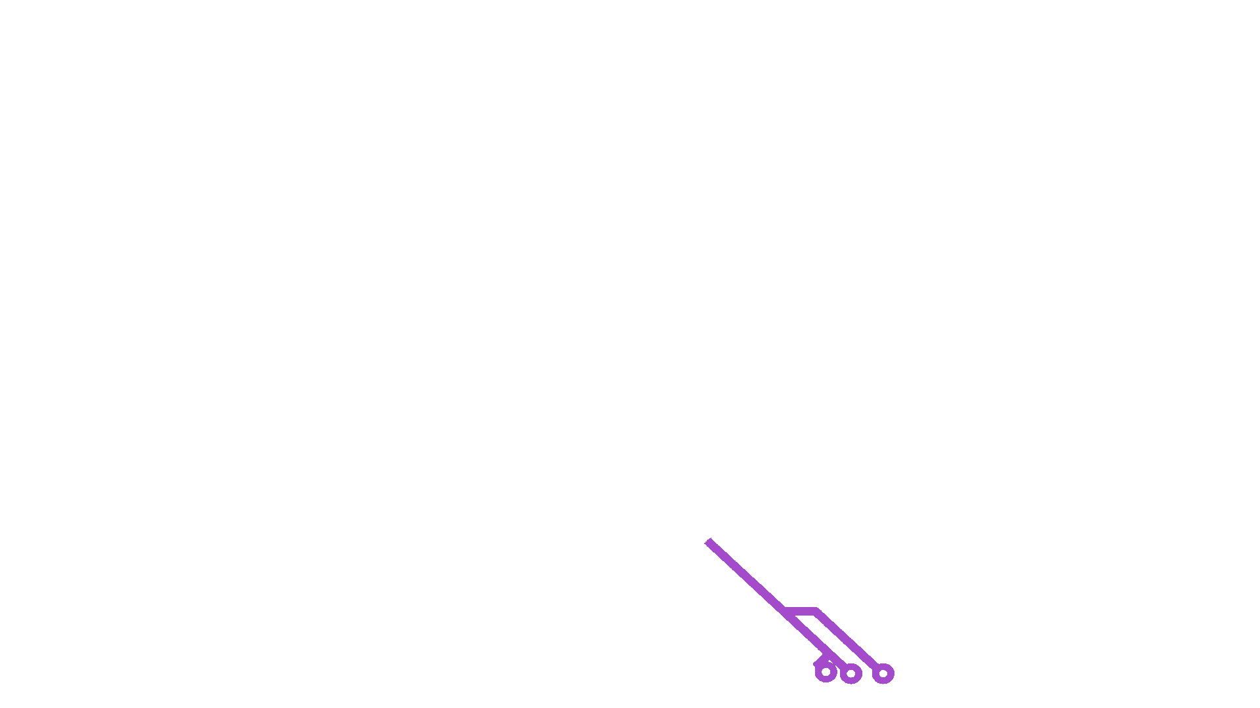
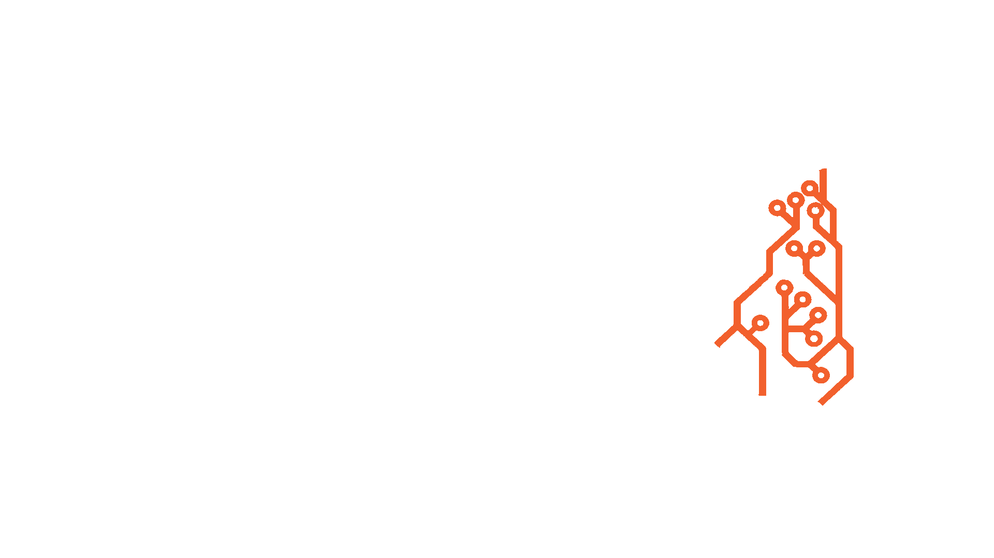
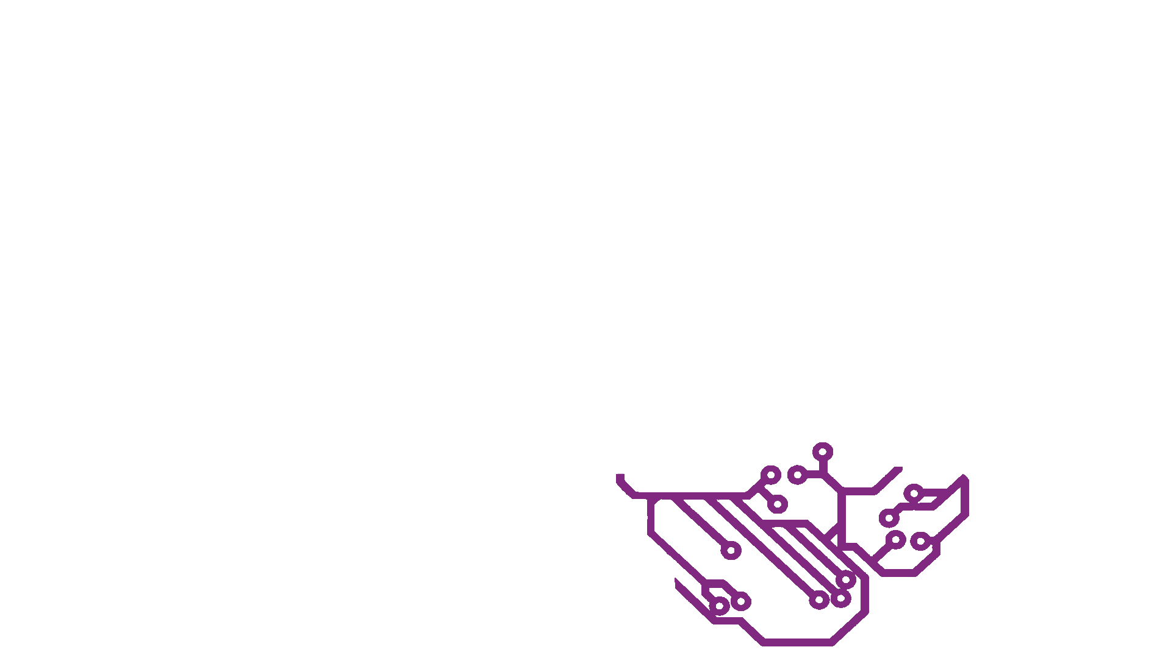

AI Brain
By Jakub J. Dylag
Parietal Lobe: Logistic Regression
Occipital Lobe: Computer Vision
Frontal Lobe: Neural Network
Eyesight
Interprets Images
Cerebellum: Decision Trees
Brain Stem: Linear Regression
Cerebrocerebellum: Random Forest

Slide 3
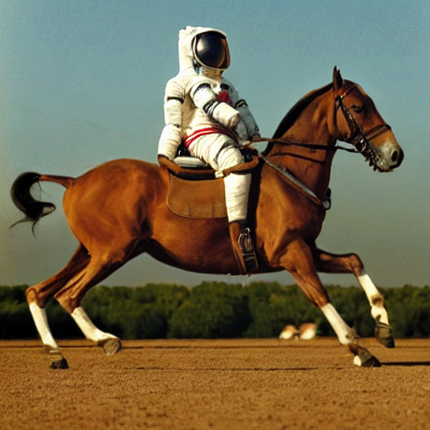
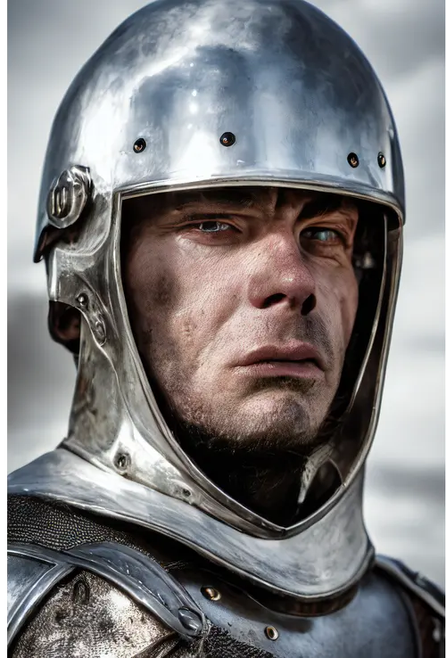
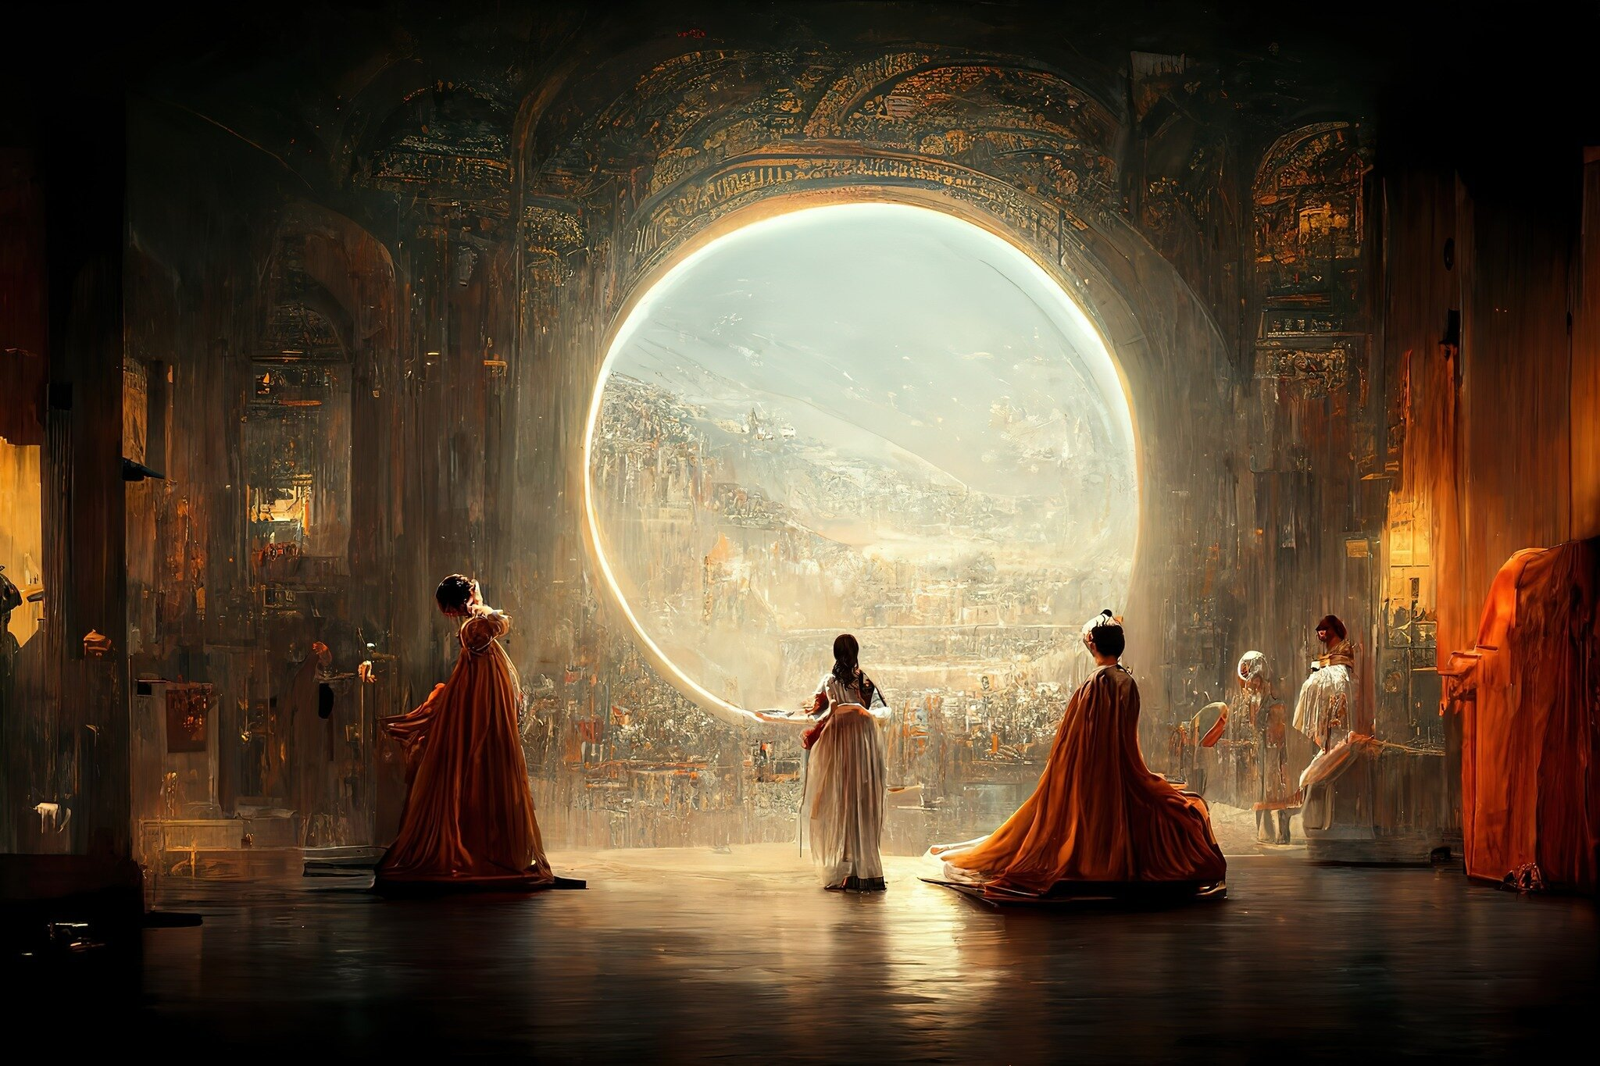
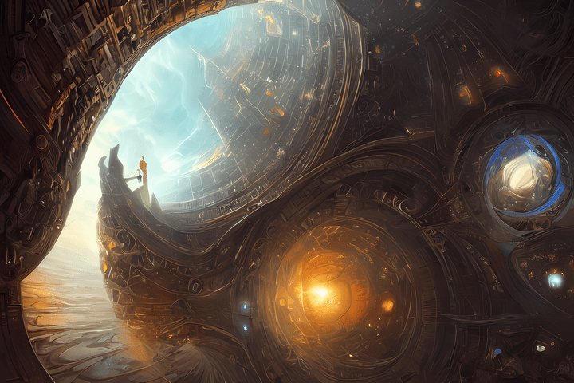
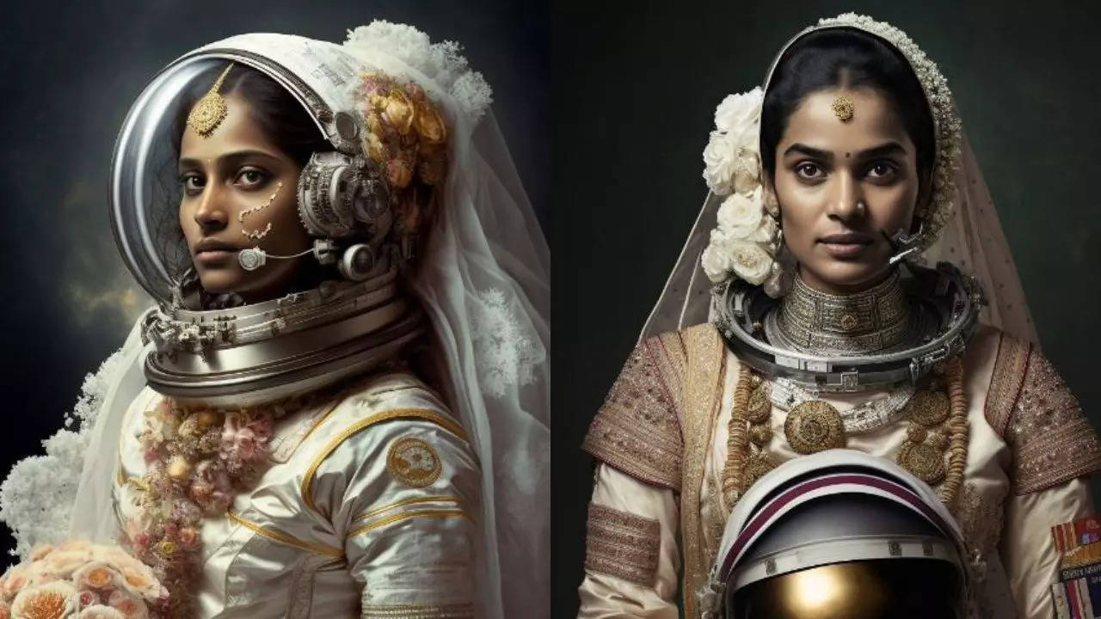
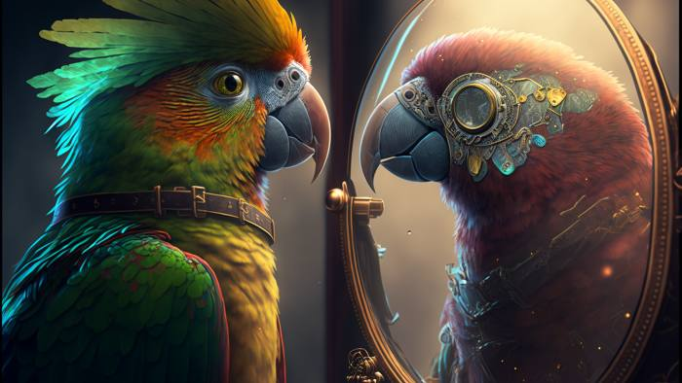
Recognise these?
By Jakub Dylag​

Slide 4


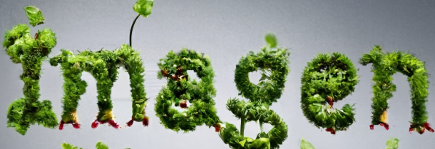

Recognise these?
By Jakub Dylag​

Slide 5
Recognise these?
££££££
Based on GPT3 Encoding ​
Open under RAIL-M
££££££
££££££
Ran from Discord
Based on Transformer T5​ Encoding
Generate 64x64 image and upscaled twice to 1024x1024
By Jakub Dylag​

Slide 6
Stable Diffusion
Latent Diffusion Models:
By Stability AI, CompVis LMU, and Runway
with support from EleutherAI and LAION.
By Jakub Dylag​

Slide 7

A Picasso painting of Shrek
By Jakub Dylag​

Slide 8
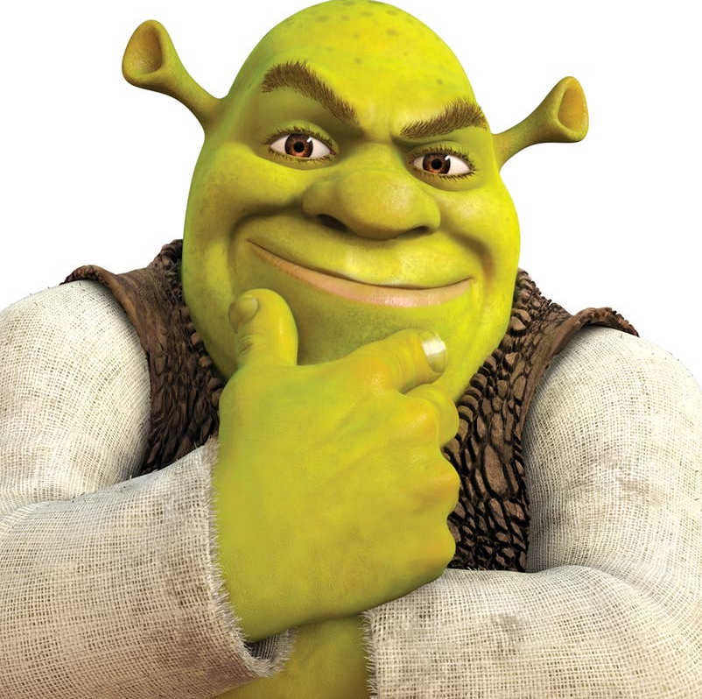
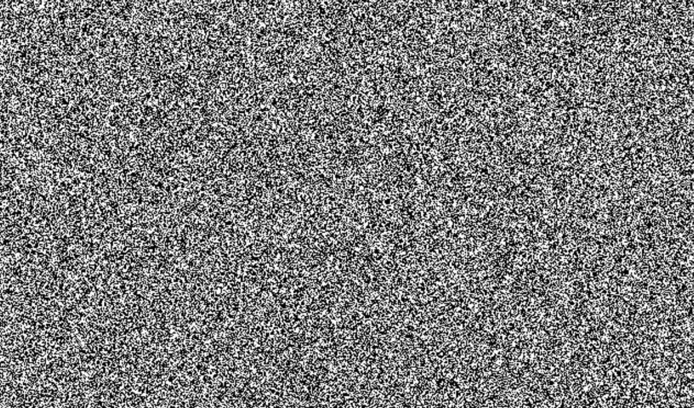
Diffusion Models: Training
By Jakub Dylag​
Notes:
Mixed up
Random ordered images with random amounts of noise

Slide 9
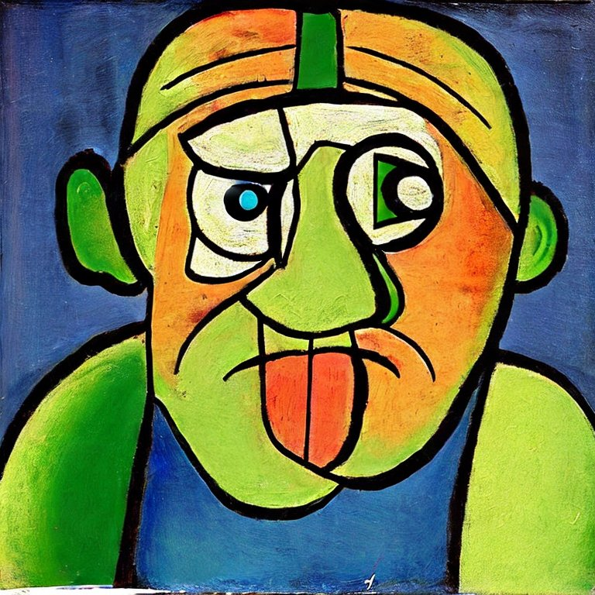
Diffusion Models: Running
By Jakub Dylag​
Notes:
Denoising the image by predicting the noise

Slide 10
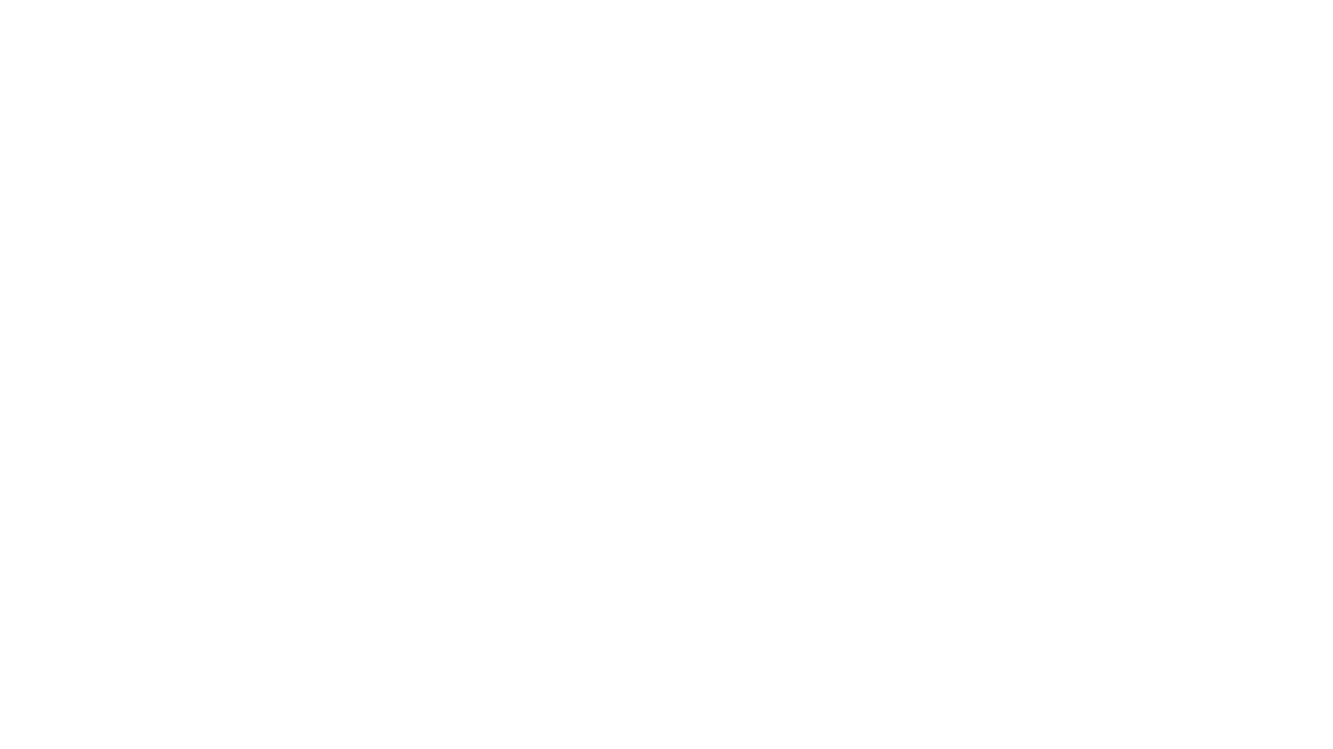
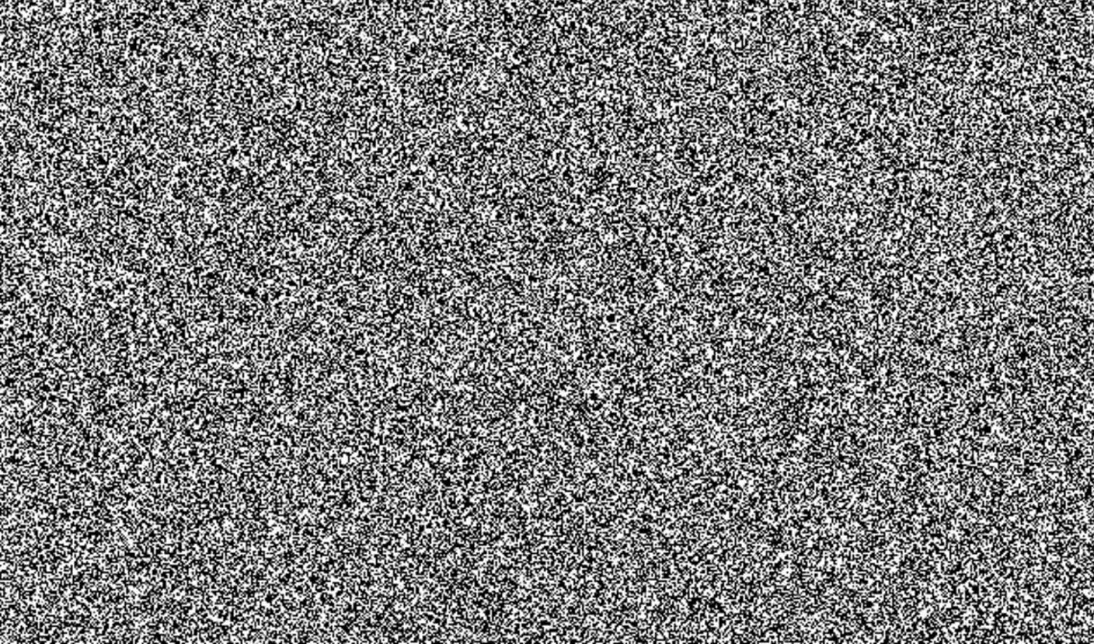
U-Net
Unconditional Image
(Noise)
Conditional Prompt
"Shrek"
U-NET
Predicting the Noise
Final Image
By Jakub Dylag​
Notes:
U-net helps us reverse this process
Denoising
Predict the noise so model doesn't have to "remember" the inputs1

Slide 11
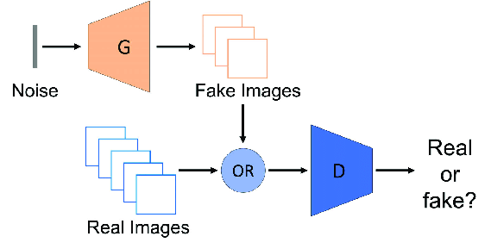
GAN: General Adversarial Network
Decoder
Encoder
By Jakub Dylag​
Notes:
Generator = Decoder
tries to make fake images
Discriminator = Encoder
tries to detect fake images from real

Slide 12
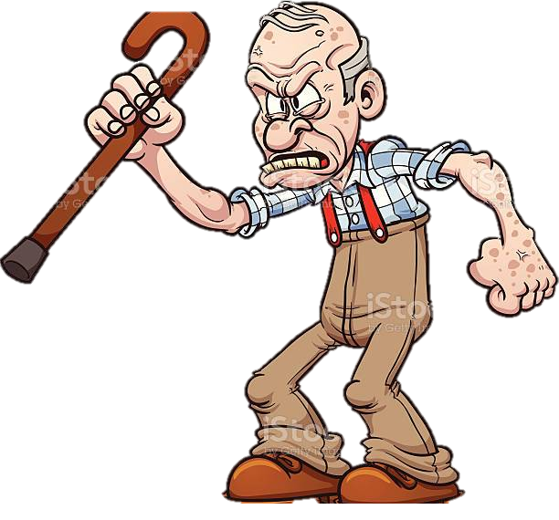
GAN: General Adversarial Network
By Jakub Dylag​
Notes:
Old tech :(
GAN project into “latent space” – tries to learn data distribution
LDM uses Gaussian Noise to form Markov Chain – learns to reverse noise (denoising)
What is latent???

Slide 13
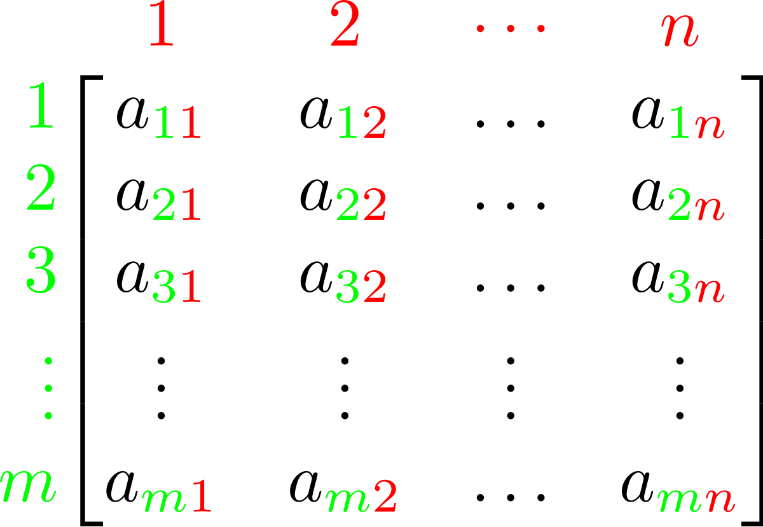
Latent Diffusion Models
Latent
/ˈleɪt(ə)nt/
existing but not yet developed or manifest; hidden or concealed.
"diabetes may be latent for some years before diagnosis"
By Jakub Dylag​
Notes:
Latent…
Vector / Matrix (a result of the encoder)
Can use this in our diff models … Latent diff models
Any Idea why we work on vector instead of images

Slide 14


CLIP: Contrastive Language-Image Pre-Training
Multi-Modal Deep Learning
Leverage data from 2 modalities: Image and Text
By Jakub Dylag​
Notes:
As humans we
see objects,
hear sounds,
feel the texture,
smell odours,
and taste flavour

Slide 15
U-Net
Unconditional Latent
(Noise)
Conditional Latent
"Shrek"
U-NET
Predicting the Noise
Final Latent
By Jakub Dylag​

Slide 16
VAE: Variable Auto Encoder
Latent
New Generated Image!
By Jakub Dylag​

Slide 17
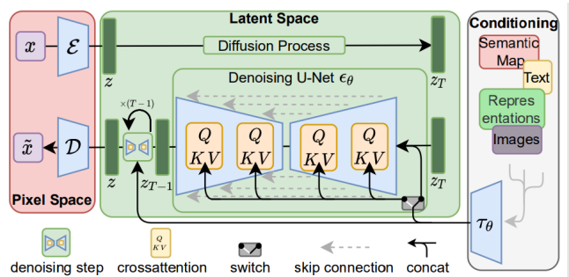
Latent Diffusion Models
CLIP
Gaussian Noise
VAE
U-Net
By Jakub Dylag​
Notes:
Stable Diffusion architecture - Similar across most diffusion models
CLIP = image to latent
Add noise (no needed – as already starting with pure noise)
U-Net reverses noise = more detail later
VAE = latent to image

Slide 18
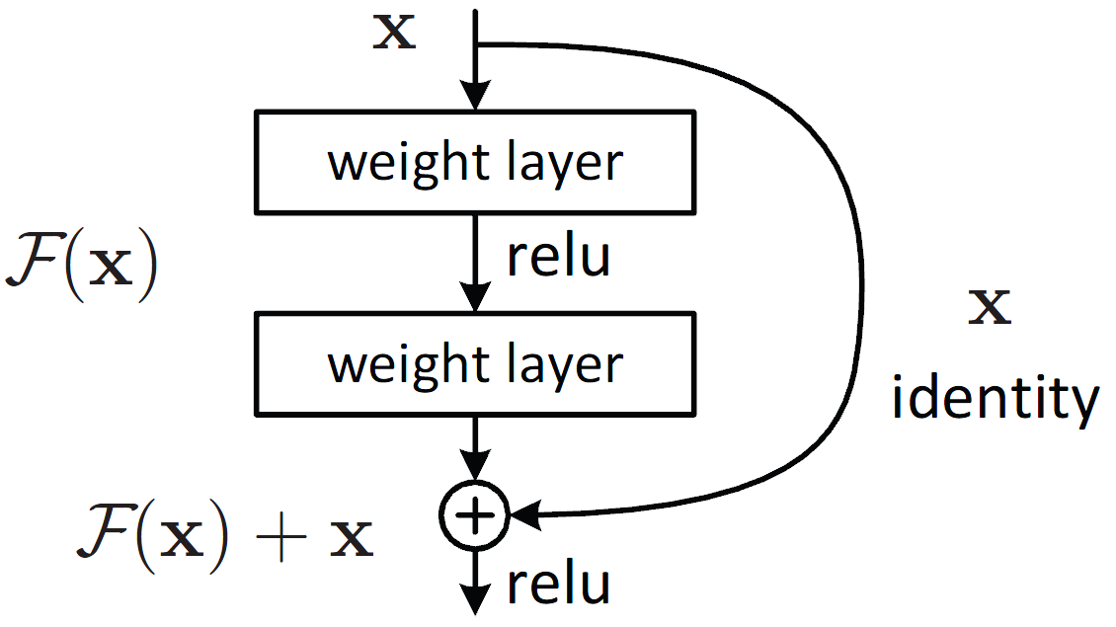
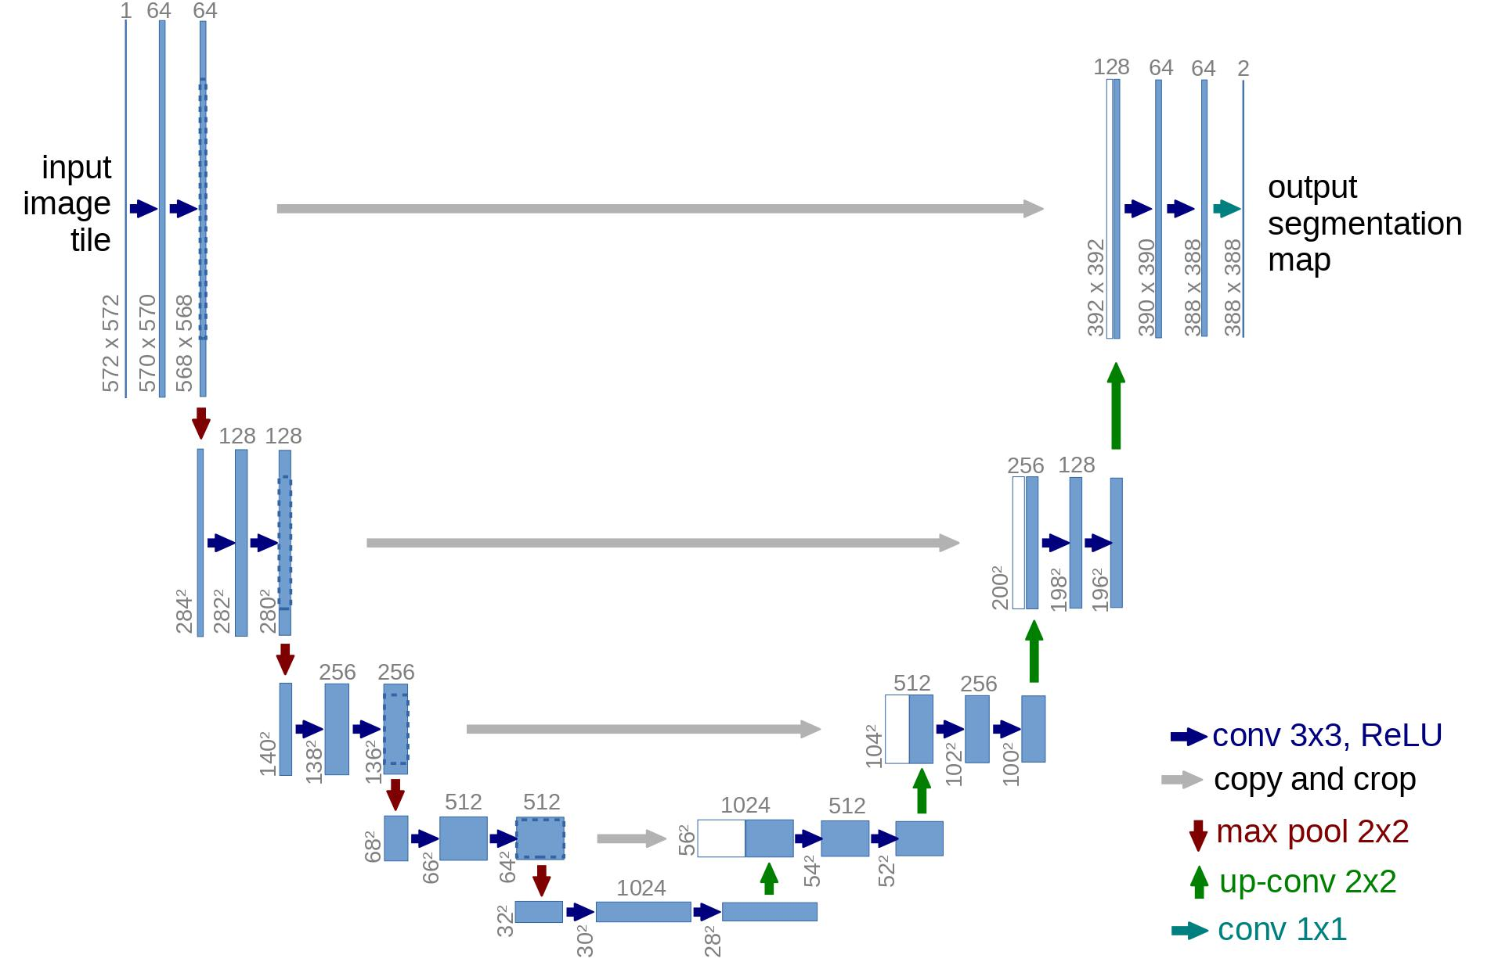


U-Net
Residual Connections
Form "ResNet Block"
Residual Connections
TN
TN-1
Down-sample
(Convolution)
Up-sample
(De-Convolution)
ResNet Block
ResNet Block
Stride = 2
Stride = 2
By Jakub Dylag​
Notes:
U-net as U-shape – developed for image segmentation
like an auto-encoder
Down sampling – encoder “abstracting”
"bottle neck" in the middle
Up sampling – decoder “de-abstracting”
Residual connections (Skip connections)
Original input is summed with the "processed" output
“Skip” some layers
Tackle the Vanishing gradient problem … covered in previous RNN workshop
e.g. ResNet50, VGG16 – ImageNet

Slide 19
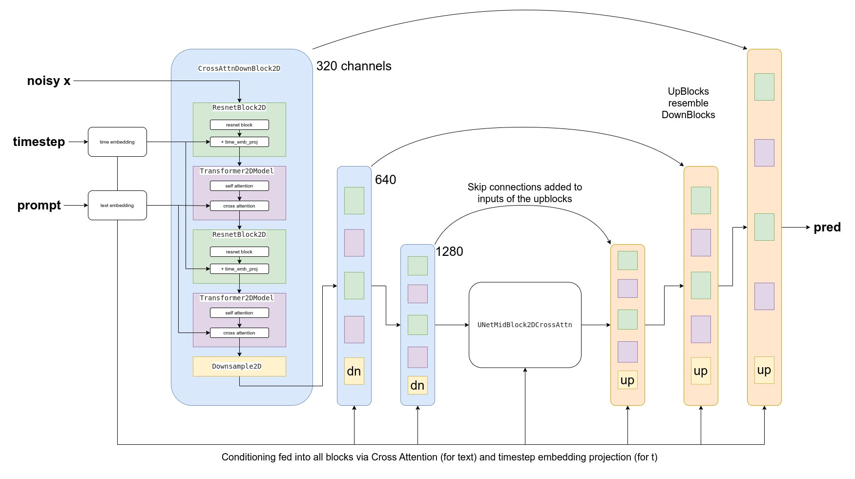
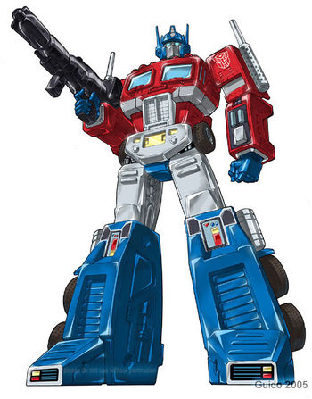
Conditional U-Net
Same as before …
TN
TN-1
Attention Layers in between!
“Shrek”
“Shrek”
Notes:
Need to condition on our prompt – “Aim towards it”
Use Cross-attention layers
- Featured in famous Transformer Architecture

Slide 20
Cross Attention
W_{Q}
Q
QK^{T}
Softmax(Q⋅K^{T})
K
Softmax(Q⋅K^{T})⋅V
W_{K}
“Shrek”
W_{V}
Residual connection again!
V
https://www.youtube.com/watch?v=aw3H-wPuRcw
Notes:
Need to condition on our prompt – “Aim towards it”
Use Cross-attention layers
- Featured in famous Transformer Architecture

Slide 21
Reserve Diffusion Process
U-NET
U-NET
U-NET
U-NET
“Shrek”
“Shrek”
Around 100 steps …
By Jakub Dylag​
Notes:
Same U-Net
Processed multiple times
Usually around 100 steps

Slide 22

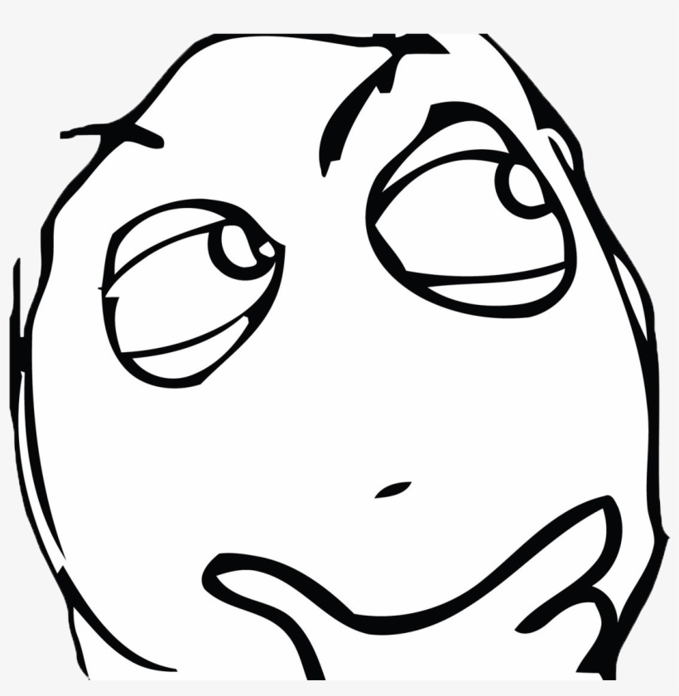
Questions?

Slide 23
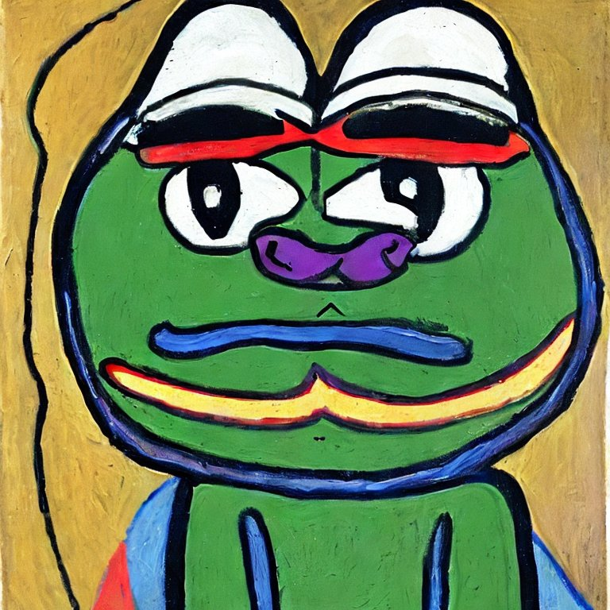
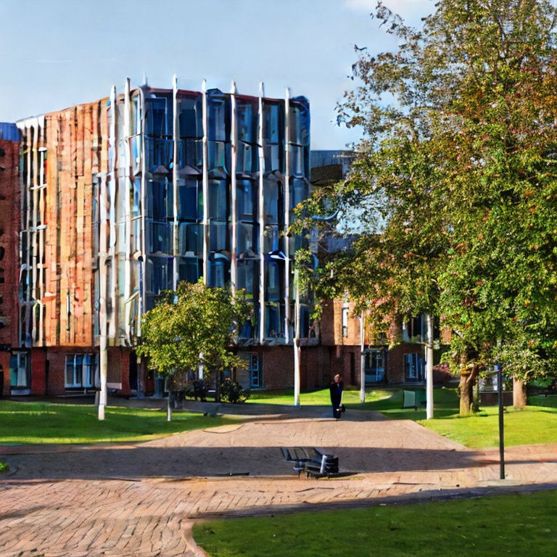
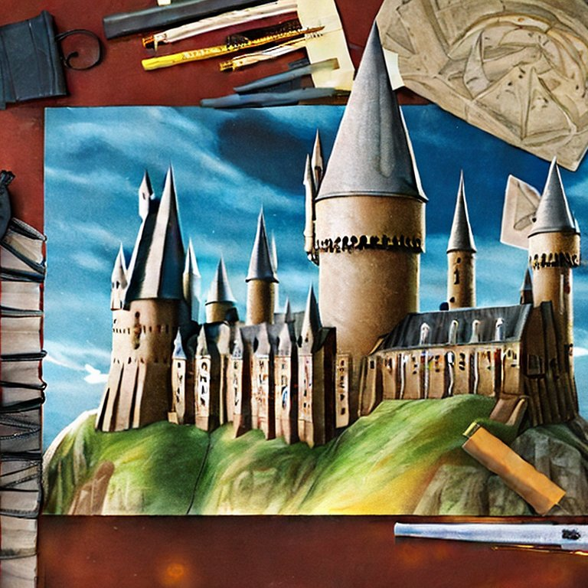
Try it!
https://huggingface.co/spaces/stabilityai/stable-diffusion
By Jakub Dylag​

Slide 24

What makes a good prompt?

Slide 25
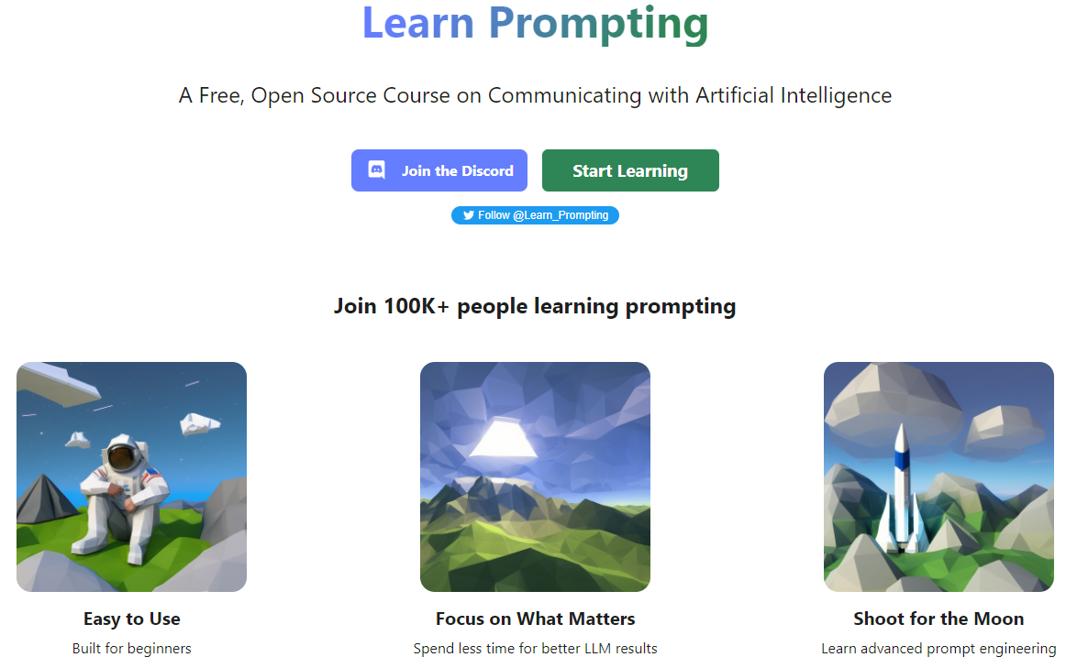
Become a Prompt Master!
https://learnprompting.org/

Slide 26
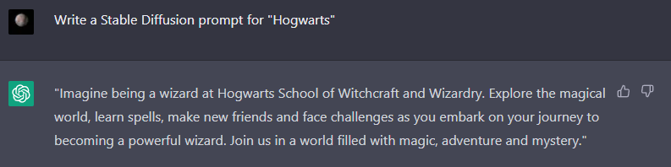
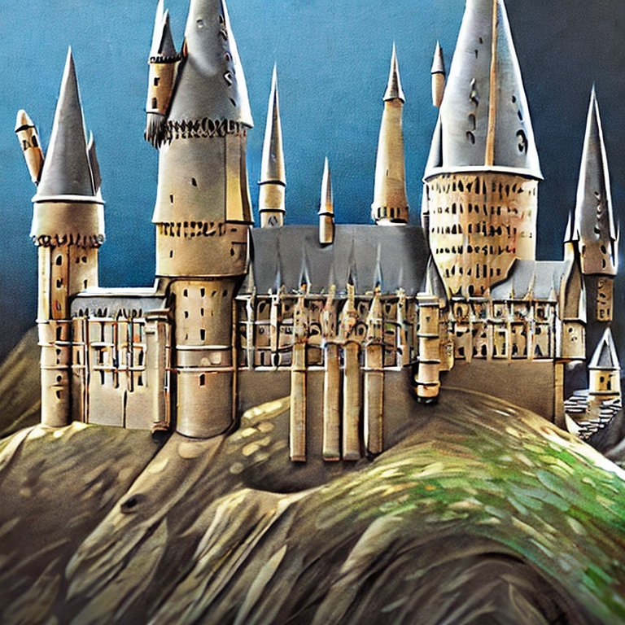
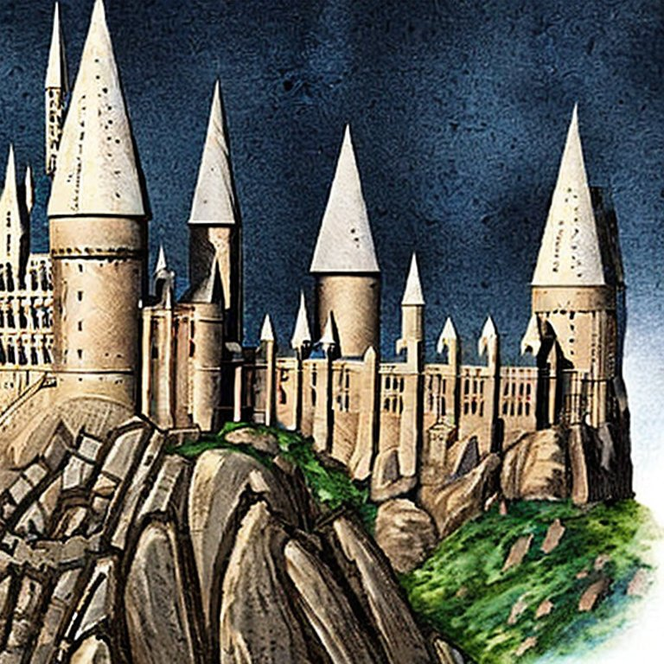
Too lazy to write your own prompts? ChatGPT😎
By Jakub Dylag​

Slide 27

Research

Slide 28
Fine Tuning
Nitro Diffusion
Disney Style
Archer Style (Cartoon)
Arcane Style (3D/2D animation)
Pokemon
Japanese
By Jakub Dylag​

Slide 29
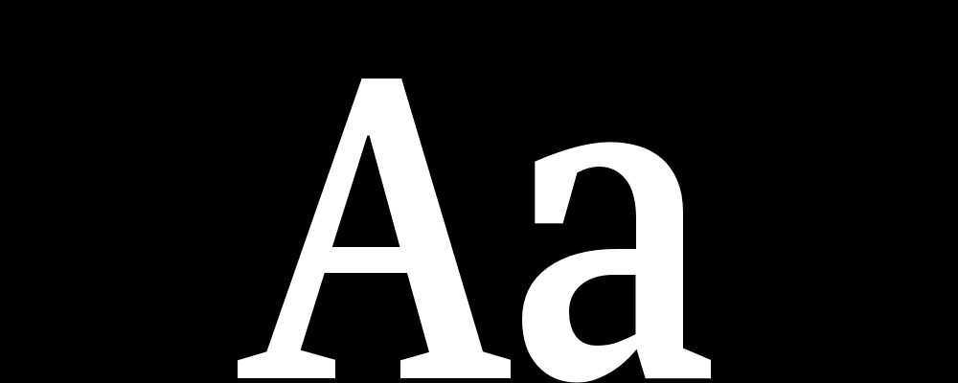
U-Net
Unconditional Latent
(Noise)
Conditional Latent
Prompt
Image
Highlighted Areas
Symbols
Final Latent
By Jakub Dylag​
Notes:
Random seed at the start

Slide 30
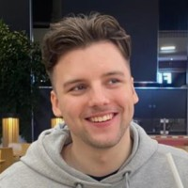
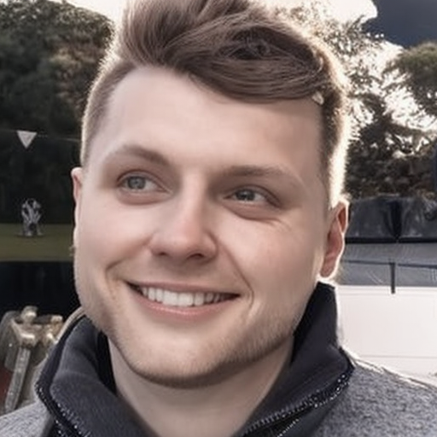
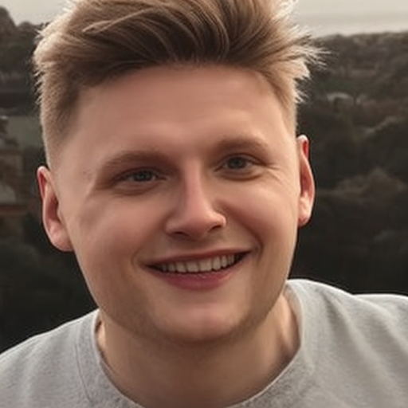
Image Variations
https://huggingface.co/spaces/lambdalabs/stable-diffusion-image-variations
By Jakub Dylag​

Slide 31
Many Inputs!
Unconditional Generation (no prompt)
Image Variations
Image-to-Image translation
Image Inpainting
Image Extrapolation
Super Resolution
By Jakub Dylag​

Slide 32
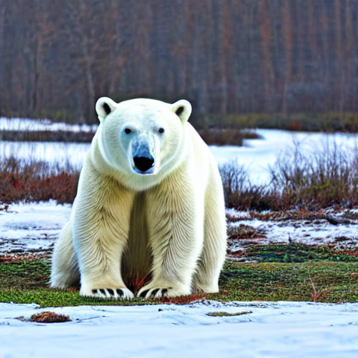
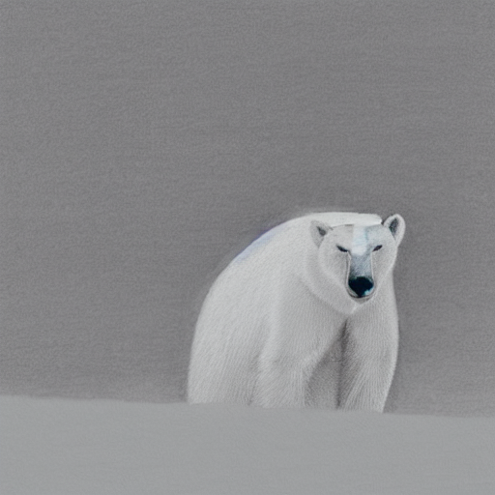
Editorial Prompts (Prompt-to-Prompt)
“A minimalist drawing of Polar Bear sitting”
minimalist drawing+10
Original: “A photo of a Polar Bear sitting”
By Jakub Dylag​

Slide 33
Cross Attention
Cross Attention Layers
By Jakub Dylag​

Slide 34
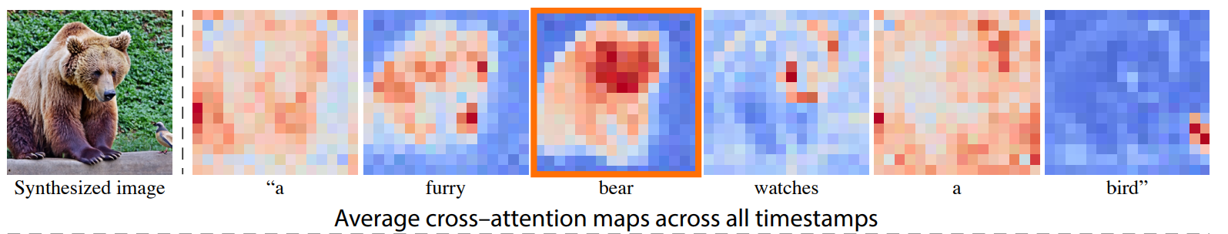
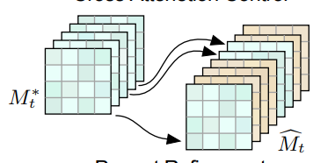
Cross Attention Map
DAAM
https://arxiv.org/abs/2210.04885
https://prompt-to-prompt.github.io/ptp_files/Prompt-to-Prompt_preprint.pdf

Slide 35
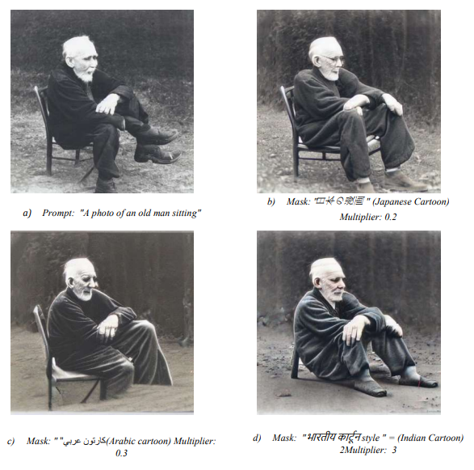
Automatic Geo-alignment of Artwork in Children's Story Books
Jakub J. Dylag, Victor Suarez, James Wald, Aneesha Amodini Uvara
Instead of changing just the style, change the culture!
Compared 3 Methods
Prompt Engineering
Add keywords to prompt
CLIP Embedding Mask
Encode foreign text with CLIP and merge with English prompt
Cross Attention Control
Slicing Attention Maps (Previous Slide)
https://arxiv.org/abs/2304.01204
Notes:
For my Master’s GDP…

Slide 36
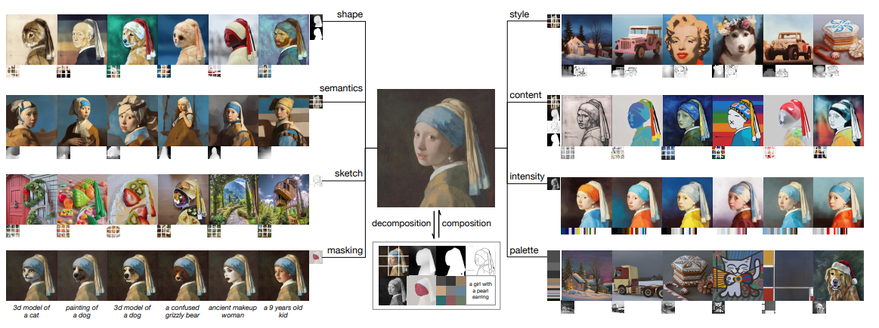
Multiple Conditions & Bi-directional Guidance
https://arxiv.org/pdf/2302.09778.pdf
Notes:
Multiple Conditions (CFG)
given weight to each condition
Context Free Guidance -> Bidirectional guidance
reverse: image to its latent using a condition c1
normal: latent to image using condition c2
can extract representations by looking at difference between c1 and c2
Immense personalisation for artists and creators

Slide 37
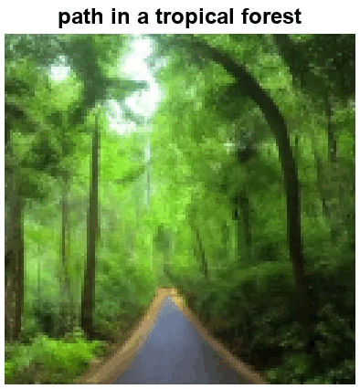
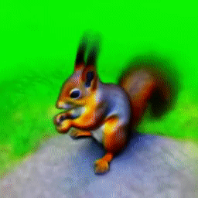
3d Models
Video
Text-conditioned Video Generation
Currently quite GPU intensive
Neural Radiance Fields
Takes multiple generated images and creates 3D pixel representation
Video Diffusion: https://arxiv.org/abs/2204.03458
DreamFusion: https://arxiv.org/abs/2209.14988

Slide 38

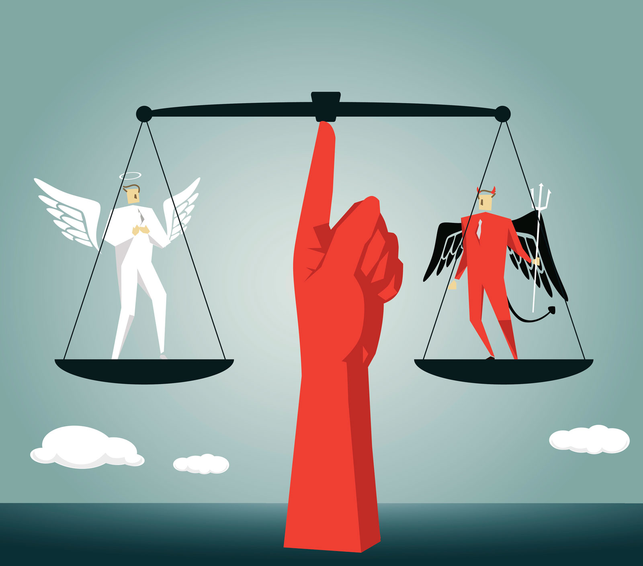
Bias, Ethics and Legal
Getty Images is suing!
LAION-5B Training set
Transformative of Derivative work?
Responsible AI Licence (OpenRAIL-M)
Favours Western Culture
Bad performance on Non-English prompts
Fewer training data means worse performance
By Jakub Dylag​

Slide 39
Questions?

Slide 40
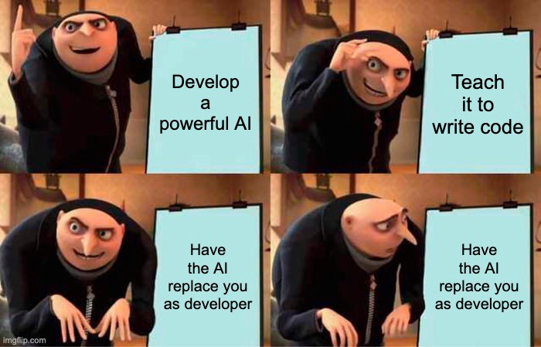
Coding

Slide 41
Let’s Code
Sign up to Hugging Face
Generate Hugging Face Token
Get code from GitHub: https://github.com/aisoc/Workshops-22-23
Open "8 - LDM"
Run "Generate_image.ipynb"
Google Collab
Draw like Picasso!
By Jakub Dylag​

Slide 42
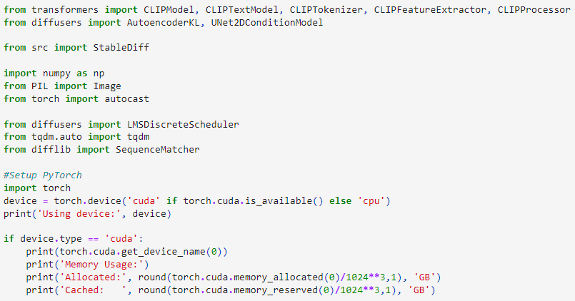
By Jakub Dylag​

Slide 43
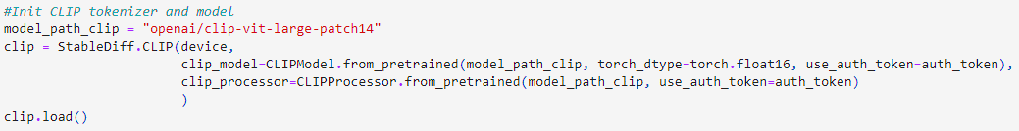

May need to setup account, and accept model's policy before being able to download
By Jakub Dylag​

Slide 44
Image
Prompt
CLIP Feature Extractor
(BERT)
CLIP Tokenizer Fast
Pixel_values
Input_ids
Attention_mask
CLIP Vision Model
CLIP Text Model
Vision_output
(77x1024)
Text_output
77x768)
vision_projection
text_projection
(77x768)
(77x768)
Image Embedding
Text Embedding
By Jakub Dylag​

Slide 45
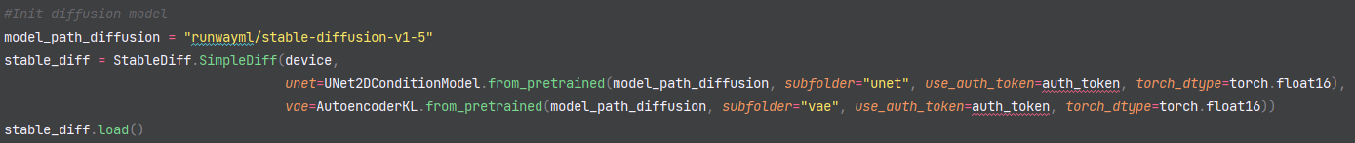
Let’s Code
By Jakub Dylag​

Slide 46

Let’s Code
By Jakub Dylag​

Slide 47

Let’s Code
By Jakub Dylag​

Slide 48

For more detailed “from scratch” code:
https://huggingface.co/blog/annotated-diffusion
(Not Stable Diffusion – it’s unconditional)

Slide 49

Slides: www.aisoc.uk/workshops/ldm
By Jakub Dylag​

Slide 50

www.aisoc.uk/articles/word-embeddings

Slide 51
Good Luck!

